Slide 1
SPOTIFY DATA ANALYSIS by Music Notes
KathLeen
Carmen
Michelle
Veethika
01/11/2024

Slide 2





One good thing about music, when it hits you, you feel no pain ~ Bob Marley

Slide 3
Hypothesis:
“When the world shut down on March 17, 2020, music consumption via the streaming platform Spotify experienced a statistically significant change.”

Slide 4

Data Collection
Music Data was collected from Kaggle.com (from Spotify) and the Spotify API
Conducted data cleaning to perform exploratory data analysis (EDA) and data visualization of the Spotify dataset using Python (Pandas, NumPy, Matplotlib)
Data analysis - Exploring the relationship between the audio features of a song and how positive or negative its impact is on streaming, involving sentiment analysis and many more.
Use data to identify patterns and relationships between different characteristics. The activity will support in developing ability to review and interpret a dataset.
Explore if there was any impact to streaming before and after Covid

Slide 5
Data Cleaning
“Genre” was defined too broadly for comparisons
Master Genre key created
Column added and populated from the key
“Month” and “Year” columns added for cleaner data grouping
New csv output for analysis

Slide 6
Data Visualization
Matplotlib was used to display bar charts of the following
Streams by Genre per Year
Streams by Genre per artist and year
Streams by Genre

Slide 7
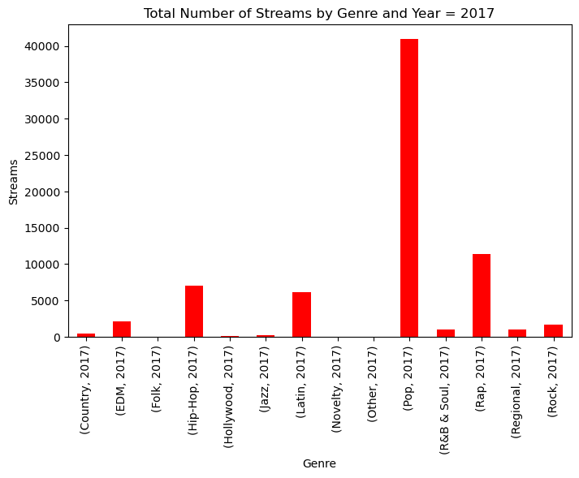
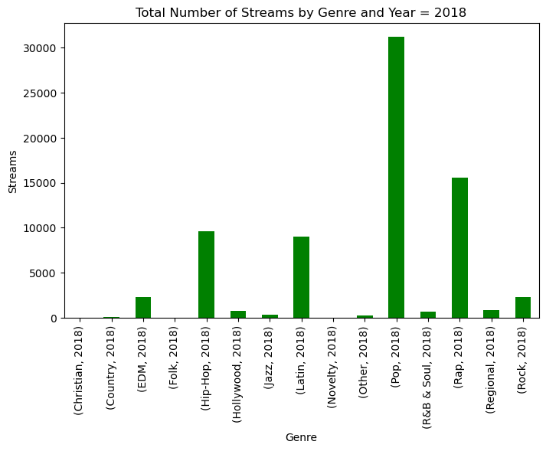
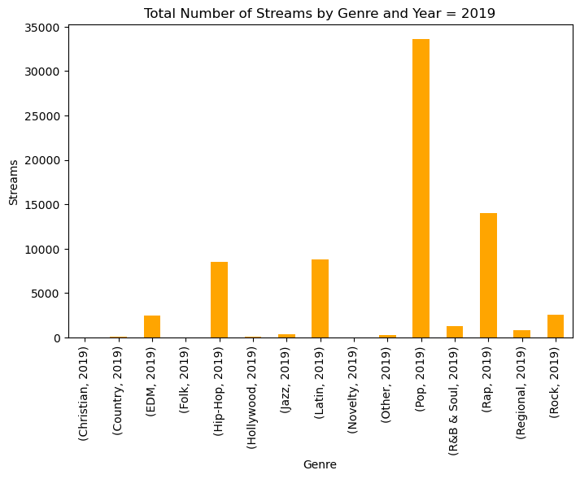
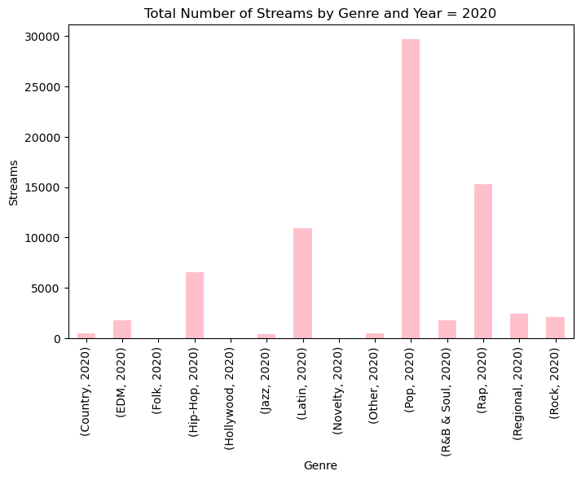
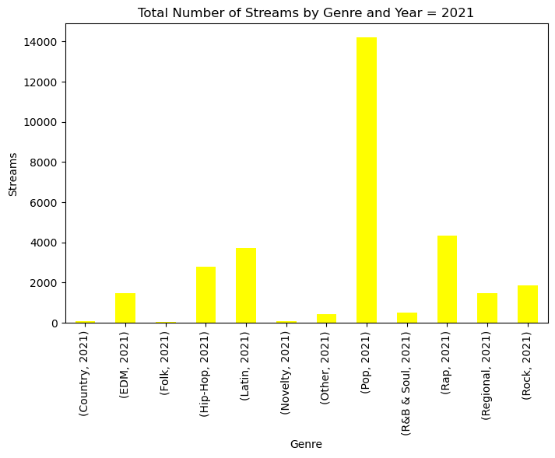
Data Visualization – Change in Genre by Year(2017-2021)
No Significant change was found in the years before , during and after covid. Pop remained the most popular Genre followed by Rap

Slide 8
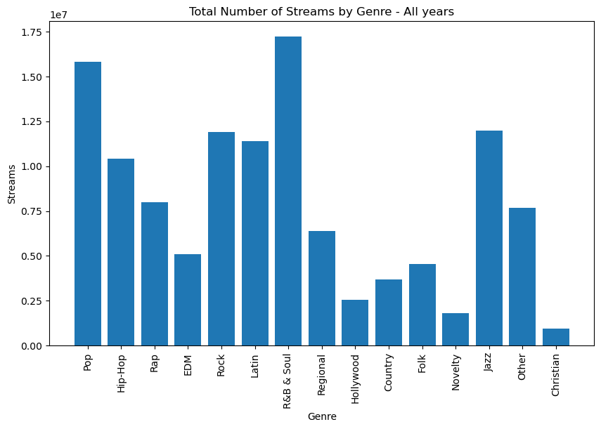
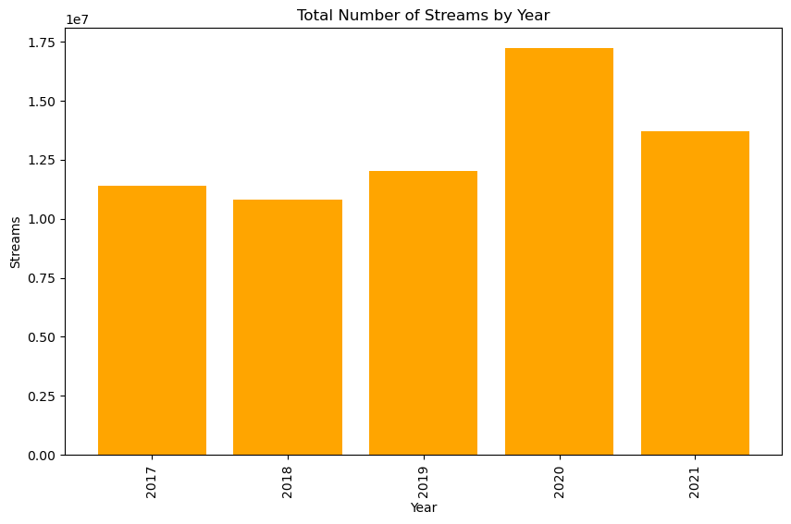
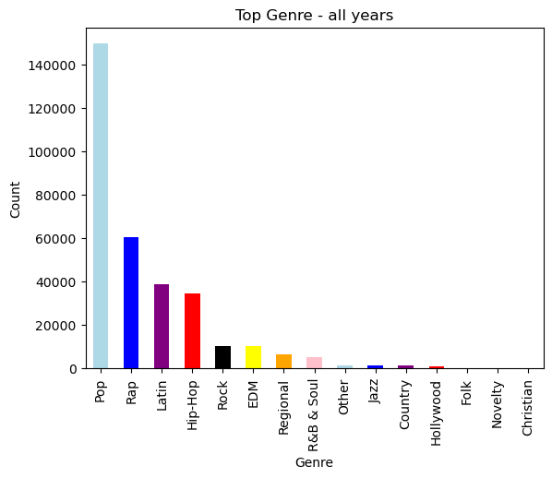
Data Visualization – Most streamed Genre
There was not much change in the type of music that was downloaded. Overall, across all years Pop genre is the most popular.
There was a slight Increase in Spotify streaming during Covid for all genres
R&B was the most streamed with repetitions

Slide 9
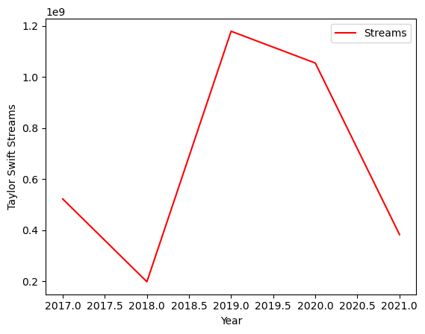
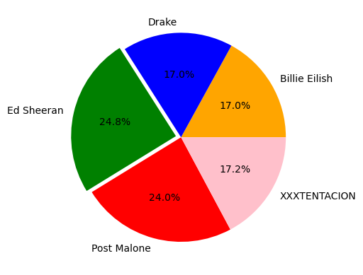
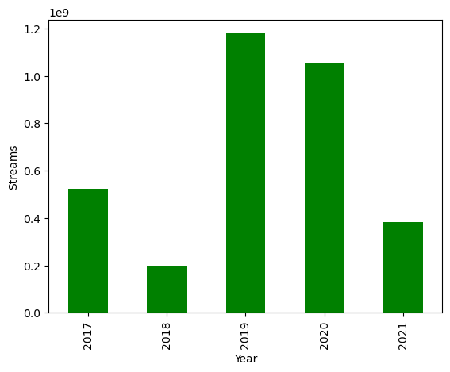
Data Visualization – Most streamed Artist for all Genres
Some Artists’ popularity continued into covid. One Artist Taylor Swift was Sampled.
Ed Sheeran was the most popular artist across all years and genres

Slide 10
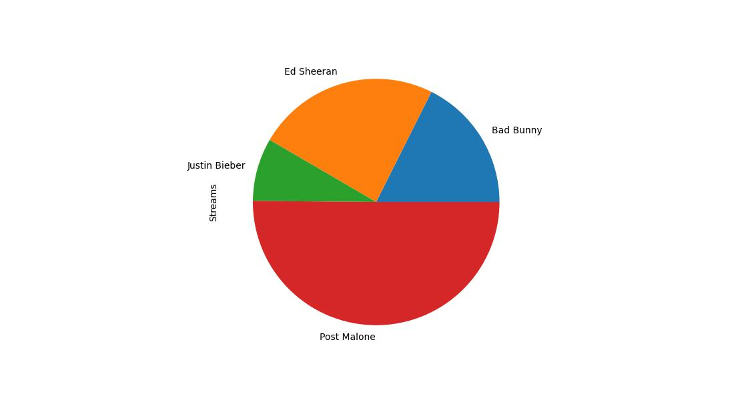
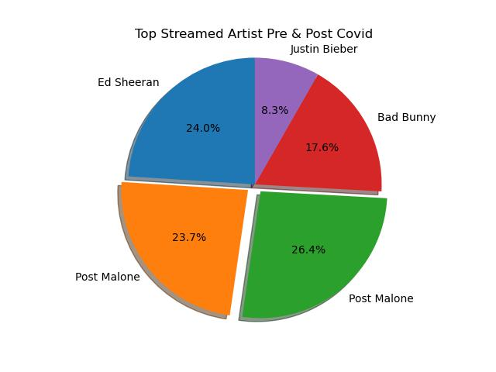
Data Visualization
Pie Chart of Most Streamed Artist Pre and post covid
Year | Artist | Streams
2017 | Ed Sheeran | 4,526,988,042
2018 | Post Malone | 4,474,074,823
2019 | Post Malone | 4,989,227,763
2020 | Bad Bunny | 3,322,524,063
2021 | Justin Bieber | 1,560,451,296
Post Malone hold first place between the years 2018 and 2019. then during covid Bad Bunny streams were the highest.

Slide 11
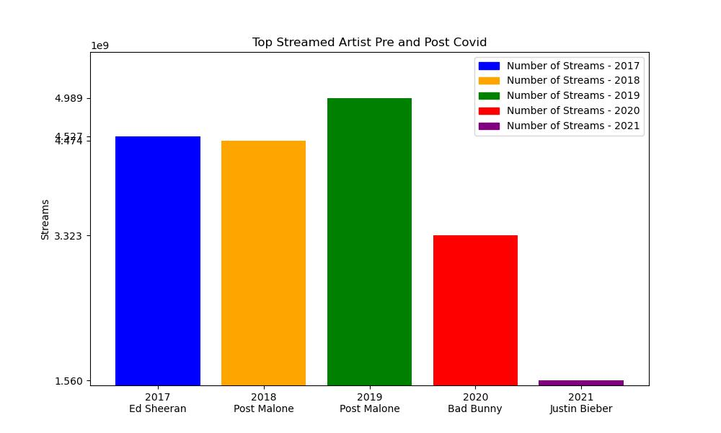
Data Visualization
Top Stream Artist Bar chart
Event though Bad bunny was not the highest Streamed Artist Through out the Years he was the most Streamed Artist in the heart of Covid Year 2020 with a 3.3 Million streamed

Slide 12
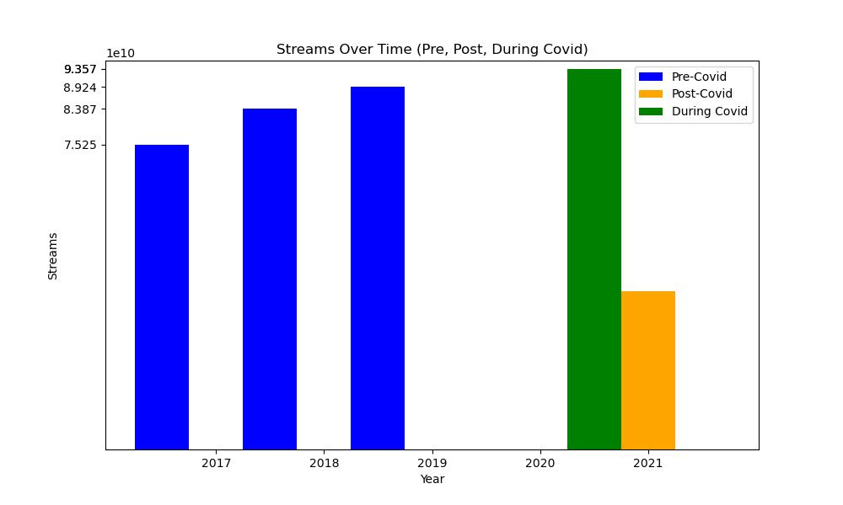
Data Visualization
Stream/Downloads per Year , Pre-During and Post Covid-19
Year | Streams
2017 | 75,248,867,959
2018 | 83,871,067,173
2019 | 89,244,533,337
2020 | 93,572,987,487
2021 | 39,775,784,728
The bar chart clearly show the music streaming increase approximately 4.0B from 2019- 2020. Also note that 2021 streaming data is for 6 month.
We estimate that the streaming for the year 2021 year end would reach 78.0 B streams.

Slide 13
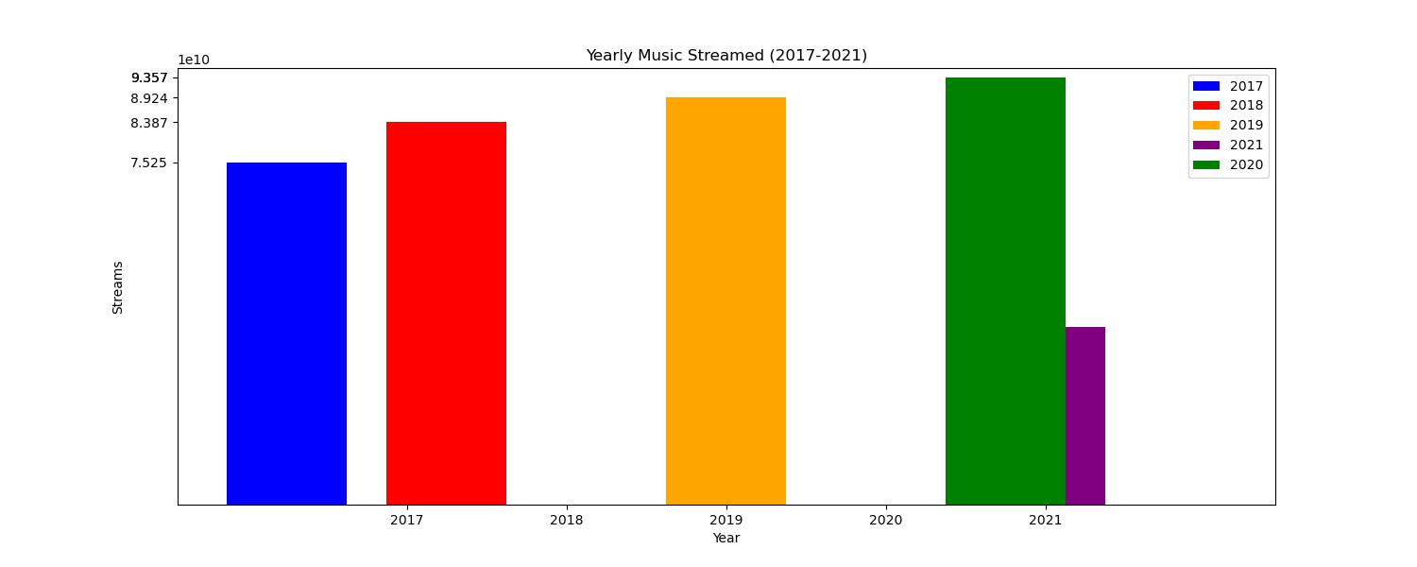
Data Visualization
Stream/Downloads per Year , Pre-During and Post Covid-19

Slide 14
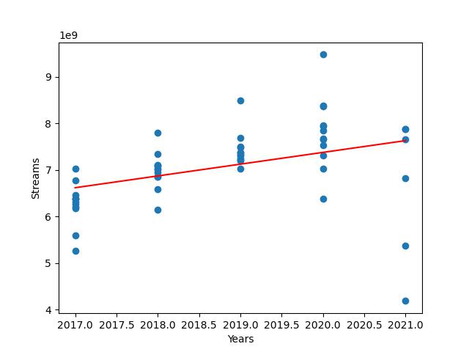
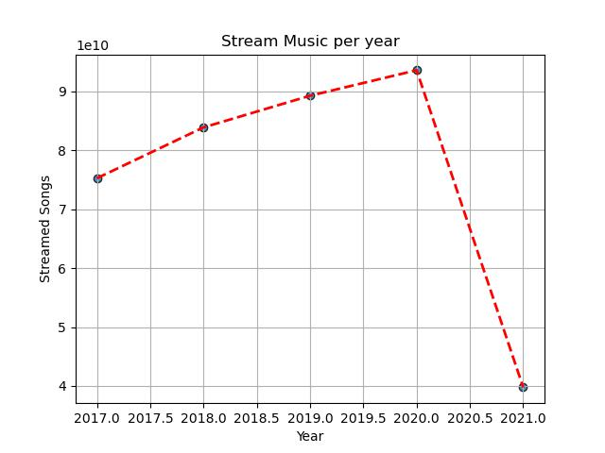
Data Visualization
Correlation between streaming Music and Covid-19
This graph shows the trend the music streaming took from 2017 – 2021
There is a positive correlation between music streamed and covid 19 era.

Slide 15
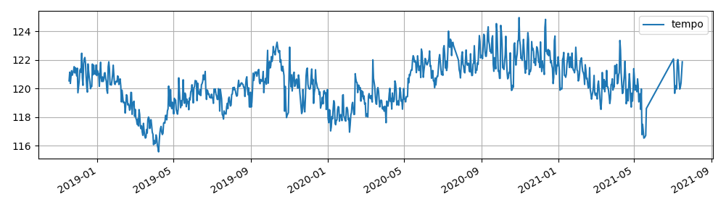
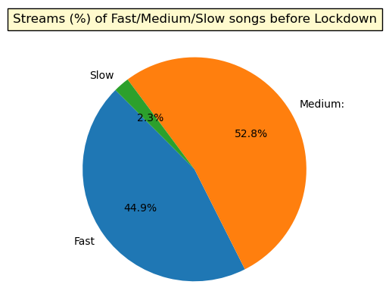
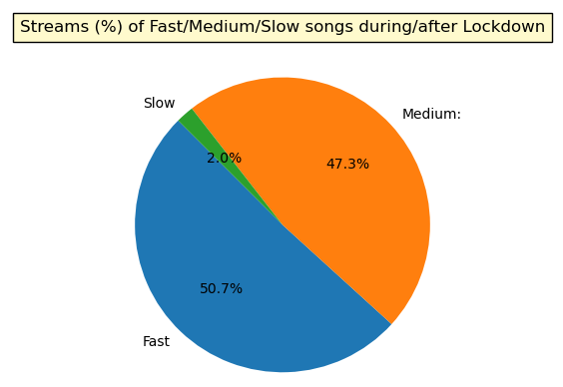
Data Visualization
Tempo is the overall estimated tempo of a track in beats per minute (BPM)
In musical terminology, tempo is the speed or pace of a given piece and derived directly from the average beat duration
Tempo was split into three different speeds for analysis
Fast > 120 BPM
Medium 76-120 BPM
Slow < 75P BPM
During post COVID lockdown, the tempo of songs being streamed saw an increase of about 6% in comparison to pre COVID lockdown numbers

Slide 16
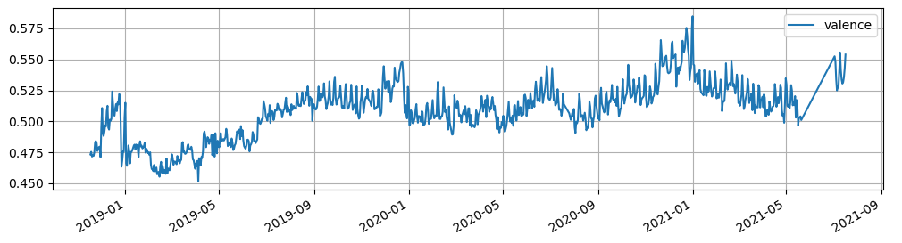
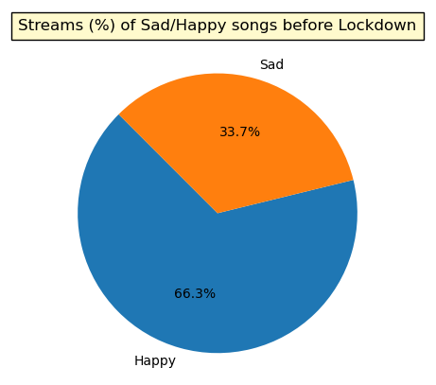
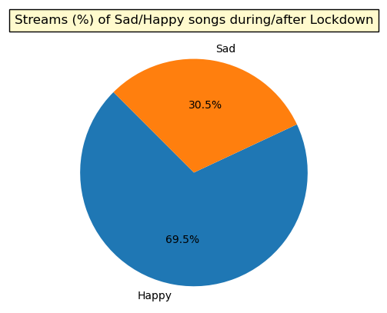
Data Visualization
Valence describes the musical positiveness or sentiment conveyed by a track
Tracks with high valence sound more positive (e.g. happy, cheerful, euphoric), which tracks with low valence sound more negative (e.g. sad, depressed, angry
Valence was split into sentiment (happy or sad) for analysis
Tracks with a valence greater or equal to 0.5 are considered “happy” songs, whereas tracks with a valence less than 0.5 are considered “sad” songs
During post COVID lockdown, the sentiment of songs being streamed saw an increase of about 3% in comparison to pre COVID lockdown numbers

Slide 17


Thank you Q & A

